Slide 1
Chapter 3
Nonlinear classification

Slide 2
Question :
“Recently, nonlinear classifiers have swept through NLP, and are now the default approach, WHY? ”
Answer :
“1. Rapid advances in deep learning nonlinear methods learning complex functions through multiple layers.
2. Incorporation of Word Embeddings as dense vector representation of words
3. Rapid advances in high speed computation using GPUs. ”

Slide 3
Nonlinear Text Classification
In this chapter we are explore about Feedforward neural networks motivation, architecture, Activation functions, and the Inputs and outputs of model.
Then we take a look at the procedure of learning neural networks, the backpropagation algorithm.
After that, we look at neural networks architectures for sequence data and the reason why they are good models for text classification.

Slide 4
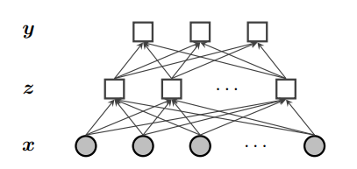
Feedforward neural networks
Example : Consider the problem of building a classifier for movie reviews. The goal is to predict a label y ∈ {GOOD, BAD, OKAY} from a representation of the text of each document, x
Z is the vector of features and a hidden layer.
We can have multiple hidden layers, z1 , z2 , . .adding even more expressiveness.
z =[z1,z2, ... , zKz]

Slide 5

Feedforward neural networks pt2
If we assume that each zk is binary, zk ∈ {0, 1}, then the probability p(zk | x) can be modeled using binary logistic regression where σ is the sigmoid function.
Also weight matrix Θ(z→y) is based on concatenation

Slide 6
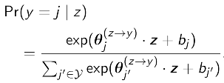

Feedforward neural networks pt3
To predict y from z we use logistic regression.

Slide 7
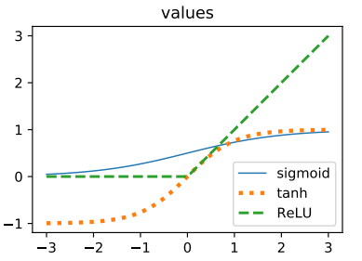
Activation Functions
The sigmoid function used to find z , and it is a activation function. We can use different functions for this purpose as well, for example:
The rectified linear unit ReLU(a) = max(0, a), which is fast to evaluate and easy to analyze.
The hyberbolic tangent tanh, which is centered at zero, helping to avoid saturation.

Slide 8

Output and Loss function
The softmax output activation is used in combination with the negative log-likelihood loss, like logistic regression.
Consider ey(i) = [0, 0,... , 0, 1 , 0, ... ,0], as one-hot vector.

Slide 9





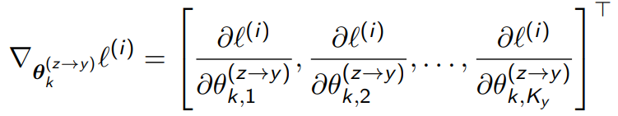
Gradient descent in neural networks
Neural networks are learned by batch gradient descent.
is the loss on instance batch i.
is the learning rate at update t
is the gradient of the loss with respect to the column vector of output weights

Slide 10
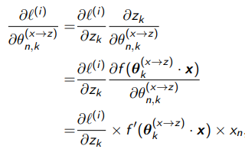
Backpropagation in neural networks
Using the Backpropagation, we compute a loss on y, and apply the chain rule of calculus to compute a gradient on all parameters.

Slide 11
Sequence Data
If we consider a text as a sequence of words w1,w2, ... ,wM. Using some structures like BOW will destroy the context behind the text. Therefore, the sequence of words should be modeled.
Neural architectures suitable for sequence data are listed as following:
Convolutional Neural Networks, which is sensitive to local dependencies between words.
Recurrent Neural Networks, which is a model of context is constructed while processing the text from left-to-right. These networks are sensitive to global dependencies.
Self-attentional Networks, which model of context is adaptive: each word can choose its own context.

